Slide 1

SBG O&M QHSE

Slide 2
INTRODUCTION
This HSE Plan gives guidelines to all levels of personnel regarding their responsibilities in effective HSE Management.
It sets high level goals and targets for effective implementation of HSE Policies and procedures.

Slide 3
This HSE plan is a tool to improve HSE standards and achieve our ultimate goal of “Zero LTI”
This safety process will be an integral part of our management
focus. Safety will be given the same priority as other processes; unless the controls fail then it will be “Safety First "We will aim to empower our employees towards proactive performance.

Slide 4
SAFETY POLICY
To improve the Standard Operating Procedures in all the project sites by following the safety guidelines from the Civil Defense, NFPA & Also according to the international safety regulatory organizations (OSHA, ISO& OHSAS).
SBG O&M believes in developing safe working procedures and maintaining a 0 injury working environment.

Slide 5
SAFETY MANAGEMENT SYSTEM
To develop and promote employee awareness with the importance of adhering to Safety Procedures, thereby ensuring protection to the worker, public and environment.
SBG O&M accomplishes this objective through effective integration of safety management into all facets of work planning and execution.

Slide 6
Occupation Health and Safety
SBG (O&M) safety management system is intended as a useful tool to achieve the following:
Protect the human asset against all job related hazards including prevention of injuries, occupational illnesses, fatalities and diseases.
Eliminate damage to material assets, facilities and related equipment.
Enhance the feeling of security, belonging and self-worth of the employees while doing their jobs.
Ensuring commitment to Saudi safety rules, regulations and safe practices.
Ensuring that all the routine maintenance activities and the corrective maintenance activities are in accordance tot the HSE Policy of the project and the working procedures are according to the OSHA, ILO, IOSH and NFPA Standards.
Ensuring continual improvement in the company overall safety performance.
Elements of Occupation Health and Safety Management System

Slide 7
LEADERSHIP & COMMITTMENT
To identify the needs of training concerned to the operation and maintenance aspect for the adequate implementation of HSE Policy in the premises of the project.
To improve the Standard Operating Procedures in all the project sites by following the safety guidelines from the Civil Defense, NFPA & Also according to the international safety regulatory organizations (OSHA, ISO& OHSAS

Slide 8
STRATEGIC OBJECTIVES
The main scope of SBG O&M is to ensure the effectiveness of the safety standards and the rules and regulations of the regulatory bodies of health and safety.
The main objective is to provide safe system of work, safe equipment of work and safe working methods to ensure the safety of employees, workplace and environment in accordance to the NFPA, OSHA, ILO and national regulatory bodies of Health and Safety

Slide 9
PROJECT HSE ORGANIZATION
The organization, resources and competence are the key factors of the success of our department in all the current projects as our organization fully exhibits all the standards implementation and the adequate hierarchy.
The resources are fully utilized to achieve maximum efficiency and the competence of the staff is enhanced by arranging workshops, training sessions and various courses registration so that we can improve our performance and enhance the benchmarking factor

Slide 10
ROLES & RESPONSIBILITIES
The roles and responsibility of each and every employ is well defined and every individual is accountable for his work as safety requires adequate responsibility and so far our performance shows that actions speaks louder than words.

Slide 11
COMPETANCE ASSURANCE
All the staff of our department and we have also arranged a portion of the evaluation of our staff on monthly basis as we have developed the employ of the month and employ of the season award for the betterment of the performance and the motivation of the staff.
We arrange certification enrolment of our competitive staff to improve the competency of our staff and the efficiency of our department.

Slide 12
AUDIT & REVIEW
SBG O&M undergoes yearly safety audit to measure the performance and evaluation of health and safety policy, rules regulations, SOP’S, working methods of the organization.
The audit undergoes the interviewing, observation and examination process with accordance to the methodology of OHSAS 18001 Lead auditor.

Slide 13
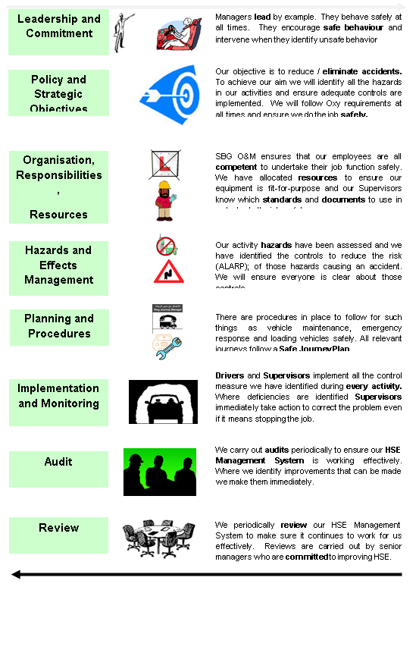

Slide 14
VISION AND POLICY STATEMENT
We will Comply with the Laws and Standards of the KINGDOM SAUDIA ARABIA
Incidents and injuries are not acceptable and should be eliminated from all company operations, continuous improvements in HSE performance will be implemented to achieve the following aspects

Slide 15
Health, Safety and Environmental Protection are a line management responsibility and they will set, The Environment shall be protected, pollution minimized, and efficient use shall be made of natural resources objectives, targets and appraise HSE performance;
Employees shall be trained to work in a healthy, safe and environmentally responsible manner;
Employees and Sub-Contractors shall be made aware that they are responsible for their own safety and health and for the safety and health of their colleagues and partners at work, in line with this Policy

Slide 16
HSE PLAN
Introduction& Safety Policy
Leadership & Commitment
Policy & Strategic Objectives
Organization, Responsibilities, Resources, Standards and Documentation
Hazards and Effects Management
Planning & Procedures
Implementation & Performance Monitoring
Audit and Review
Management Review

Slide 17
STANDARD OPERATING PROCEDURES
POLICY
FUNDAMENTAL REQUIREMENTS
Fire Safety & FIRE PREVENTION
EMERGENCY ACTION PLAN
WORK AT HEIGHT
PPE’S
CONFINED SPACED ENTRY
ELECTRICAL, FIRE, MECHANICAL SAFETY
HOUSEKEEPING
FIRST AID
MSDS
SAFETY COMMITTEE
HIGH RISK OPERATIONS EHS PROCEDURES

Slide 18
WORK METHOD STATEMENTS
Introduction And Scope
Organization, Resources And Competence
Project HSE Organization
Method Statements
Work Method Statement Samples
Method Statement Briefing Record

Slide 19
ENVIRONMENTAL AND WASTE MANAGEMENT POLICY

Slide 20
WAREHOUSE SAFETY
Objectives
Introduction/Overview
General Hazards
OSHA Regulations
Material Handling Protections & Safe Lifting
Safe Storage Practices
Safety Attitude
Chemical Hazards
Spill Response
Warehouse Actual Sample Report
Sample Report For Stores Hazards Analysis
Standards And Recommendations

Slide 21
FIRE PREVENTION & PROTECTION
VISION OF SBG 0&M
POLICY REGARDING FIRE SAFETY
FIRE PROTECTION SYSTEM AT DOKAAE PROJECT
FIRE SAFETY
FIRE FIGHTING SYSTEM AT DOKAAE PROJECT
PARTIAL SPRINKLER SYSTEM, FIRE HOSE CONNECTIONS
FIREFIGHTER EMERGENCY
FIRE DEPARTMENT NOTIFICATION
FIRST RESPONSE FIRE PROTECTION
FIRE DETECTION AND EMPLOYEE FIRE ALARM SYSTEMS
CONSIDERATIONS- SMOKE CONTROL SYSTEM

Slide 22
SAFETY STATISTIC REPORT ACCIDENTS, INCIDENTS & RISK ASSESSMENT
INTRODUCTION AND SCOPE
SAFETY VIOLATION REPORT SAMPLE
RISK ASSESSMENT METHODOLGY
SAFETY INSPECTION REPORT SAMPLE
OBSERVATION REPORT SAMPLE
SAFETY ALERT SAMPLE
SAMPLE INSPECTION REPORT OFFICES
WORK PLAN PROPOSAL SAMPLE
RISK ASSESSMENT HOTELS SAMPLE
SHUT DOWN OBSERVATION REPORT SAMPLE
SAFETY STATISTICS REPORT

Slide 23
PENALTY SYSTEM
General policy
Drug policy
Confidential information
Threats and violence
Employment of relatives
Enforcement and Discipline
Drug free workplace
Public office candidacy

Slide 24
TRAFFIC MANAGEMENT PLAN
Traffic management policy
Scope of the plan, ISO Safety
Council objective
Management of TMP
Traffic control plans
Determination of traffic control at the work sites
Traffic Controllers
Plant and Equipment &Time management

Slide 25
WORKER WELFARE POLICY
S.N | DESCRIPTION
1 | Introduction and scope
2 | Worker welfare policy
3 | Objective
4 | Fundamental principles of workers welfare
5 | Compliance with legal requirements
6 | Roles and responsibilities
7 | General requirements
8 | Management of Accommodation
9 | Record and access
10 | Guide worker communication
11 | Grievance process
12 | General facility requirements
13 | Waste water and solid waste
14 | Sanitary and toilet faculties
15 | Medical facilities
16 | Managing workers accommodation
17 | Health and safety on site
18 | Compensation to Workers
19 | Worker welfare management plan

Slide 26
TRAINING PLAN & TOOL BOX TALKS
S.N | DESCRIPTION
1 | General Policy
2 | Training Policy
3 | Fundamental Requirements:
4 | Travel Distance To Emergency Escape Routes
5 | SBG O&M Staff Induction & Training
6 | Training Plan
7 | DOKAAE Project Hotels Training
8 | Training Orders Form
9 | Lock Out Machine Training Sample
10 | COMPLIANCE WITH THIS PROGRAM
11 | SPECIFIC PROCEDURAL STEPS
12 | FALL PROTECTION WORK PLAN
13 | SBG O&M SAMPLE RESPIRATORY PROTECTION PROGRAM
14 | ACCIDENT INVESTIGATION CHECKLIST TOOLBOX
15 | TOOL BOX REGARDING EMPLOYEE BEHAVIOR
16 | TOOL BOX REGARDING ROLES & RESPONSIBILITIES
17 | FALL PROTECTION WORK PLAN TRAINING – SAMPLE
18 | ASSEMBLY, MAINTENANCE, INSPECTION, DISASSEMBLY PROCEDURE

Slide 27
EMERGENCY EVACUATION PLAN
S.N | DESCRIPTION
1 | Introduction And Scope
2 | Emergency Evacuation Procedures
3 | Evacuation Routes
4 | Emergency Phone Numbers
5 | Emergency Reporting And Evacuation Procedures
6 | Medical Emergency
7 | Fire Emergency
8 | Extended Power Loss
9 | Chemical Spill Emergency Response Plan
10 | Structure Climbing/Descending Emergencies Plan
11 | Severe Weather And Natural Disasters (Emergency Response Plans)
12 | Critical Operations & Training
13 | Emergency Evacuation Plan DOKAAE Project
14 | Emergency Drill
15 | Emergency Communication

Slide 28
MONTHLY SAFETY SAMPLE REPORTS FOR EACH SCOPE
1-1507
2-TOWERS
3-COMMERCIAL AREA

Slide 29
SAFETY MANUAL
PTW PROCEDURES
PROJECT ORGANIZATION

Slide 30
CHECKLISTS & FORMS
MONTHLY / WEEKLY SAFETY REPORT
INJURY SUMMARY
PRELIMINARY ACCIDENT REPORT
FATAL ACCIDENT REPORT
INTERNAL INCIDENT REPORT
FINAL ACCIDENT REPORT
NON CONFORMATION REPORT (NCR)
DAILY REPORT
FIRE FIGHTING EQUIPMENT,EMERGENCY LIGHTING & INSECT KILLER
INSPECTION LOG
TOOL BOX MEETING MIMUTES
FIRE EXTINGUISHER LOCATION CHECKLIST
NEAR MISS REPORT FORM
PROJECT SITE SAFETY COLOR CODING - TRANSPORT AND HEAVY
EQUIPMENT
PROJECT SITE SAFETY COLOR CODING - GAS CUTTING APPARATUS
PROJECT SITE SAFETY COLOR CODING - ELECTRICAL OPERATED HAND
POWER TOOLS
EMERGENCY CONTACTS
HAND, POWER, PNEUMATIC & CARTRIDGE OPERATED TOOLS SAFETY
CHECKLIST
LADDER SAFETY CHECKLIST
EXCAVATION DAILY INSPECTION SHEET
FORKLIFT CHECKLIST
WELFARE CHECKLIST
FABRICATED FRAME SCAFFOLDS INSPECTION CHECKLIST
ORAL SCAFFOLDING INSPECTION CHECKLIST
MOBILE SCAFFOLDS INSPECTION CHECKLIST
TUBE AND COUPLER SCAFFOLDS INSPECTION CHECKLIST
EQUIPMENT CHECKLIST
WASTE LOG
HOT / COLD WORK PERMIT
CONFINED SPACE ENTRY PERMIT
EXCAVATION WORK PERMIT
LIFTING OPERATION PERMIT
PERMIT TO WORK EXTENDED HOURS AND NIGHT SHIFT WORKING
RADIOGRAPHY PERMIT
GENERATOR INSPECTION REPORT
SAFETY CHECKLIST FOR WELDING AND CUTTING TOOLS

Slide 31
WASTE LOG
HOT / COLD WORK PERMIT
CONFINED SPACE ENTRY PERMIT
EXCAVATION WORK PERMIT
LIFTING OPERATION PERMIT
PERMIT TO WORK EXTENDED HOURS AND NIGHT SHIFT WORKING
RADIOGRAPHY PERMIT
GENERATOR INSPECTION REPORT
SAFETY CHECKLIST FOR WELDING AND CUTTING TOOLS

Slide 32
SAFETY AUDITING
S.N | CONTENTS DESCRIPTION | PAGE NUMBER
1 | SCOPE AND VISION | 6
2 | TECHNICAL ASPECT OF AUDIT | 7
3 | O&M AUDIT TEAM FUNCTIONAL RESPONSIBILITIES: | 8
4 | INTRODUCTION | 9
5 | THE PDCA CYCLE | 11
6 | Safety Auditors - Duties & Responsibilities | 13
7 | AUDIT MECHANISM | 16
8 | Pre-Start Workplace Audit Form | 19
9 | AUDIT CHECKLIST | 20
10 | REVIEWING ASPECTS OF HSE POLICY (RECOMMENDED BY SBG O&M)) | 34

Slide 33
THANK YOU

